Slide 1
Software Connectors
Guards at the gates of separation of concerns
Software Architecture
Lecture 6

Slide 2
What is a Software Connector?
Architectural element that models
  Interactions among components
  Rules that govern those interactions
Simple interactions
  Procedure calls
  Shared variable access
Complex & semantically rich interactions
  Client-server protocols
  Database access protocols
  Asynchronous event multicast
Each connector provides
  Interaction duct(s)
  Transfer of control and/or data

Slide 3
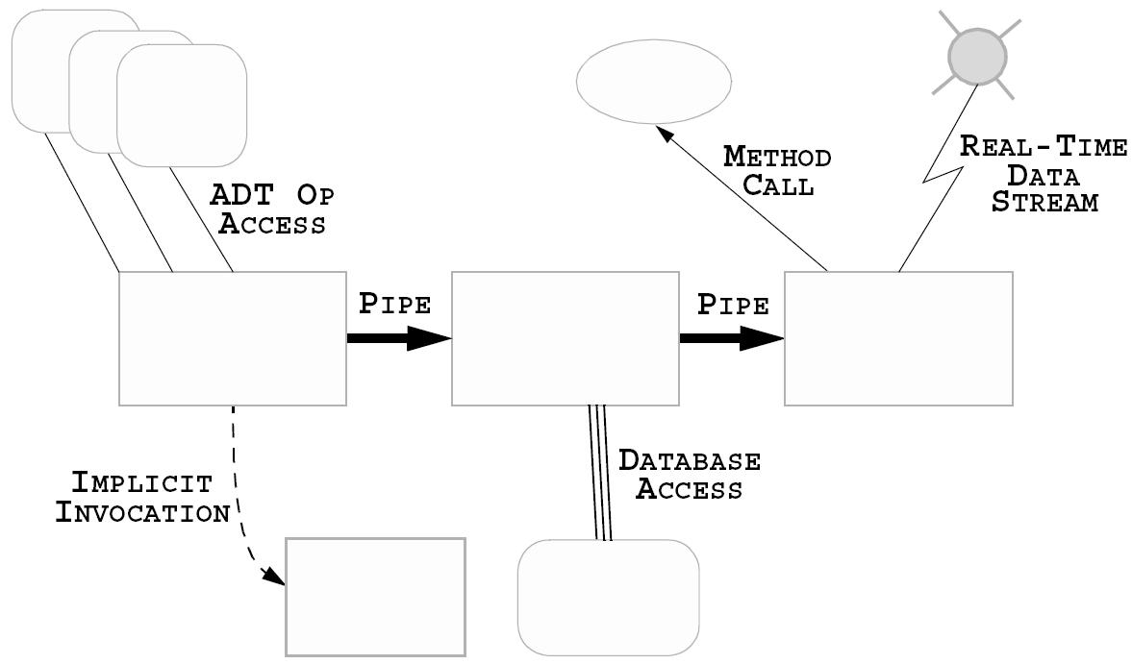
Where are Connectors in Software Systems?
Software Architecture: Foundations, Theory, and Practice; Richard N. Taylor, Nenad Medvidovic, and Eric M. Dashofy; © 2008 John Wiley & Sons, Inc. Reprinted with permission.
Notes:
An ADT is a mathematical model of a data structure that specifies the type of data stored, the operations supported on them, and the types of parameters of the operations.
In Java, an ADT can be expressed by an interface, which is simply a list of method declarations, where each method has an empty body. An ADT is realized by a concrete data structure, which is modeled in Java by a class. A class defines the data being stored and the operations supported by the objects that are instances of the class.

Slide 4
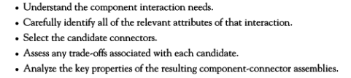
Software Architect’s Job:

Slide 5
Implemented vs. Conceptual Connectors
Connectors in software system implementations
  Frequently no dedicated code
  Frequently no identity
  Typically do not correspond to compilation units
  Distributed implementation
    Across multiple modules
    Across interaction mechanisms

Slide 6
Implemented vs. Conceptual Connectors (cont’d)
Connectors in software architectures
  First-class entities
  Have identity
  Describe all system interaction
  Entitled to their own specifications & abstractions

Slide 7
Reasons for Treating Connectors Independently
Connector ≠ Component
  Components provide application-specific functionality
  Connectors provide application-independent interaction mechanisms
Interaction abstraction and/or parameterization
Specification of complex interactions
  Unary, Binary, N-ary
  Asymmetric vs. Symmetric
  Interaction protocols

Slide 8
Benefits of First-Class Connectors
Separate computation from interaction
Minimize component interdependencies
Support software evolution
  At component-, connector-, & system-level
Potential for supporting dynamism, Example [Next slide]
Facilitate heterogeneity
Become points of distribution
Aid system analysis & testing
Notes:
Dynamism- plugins, API, esthatics
Hetrogenity- Accommodating heterogeneity: enabling an application to be composed of compo..
nents written in diverse programming languages and running on multiple, varying
hardware platforms, communicating across a network.

Slide 9

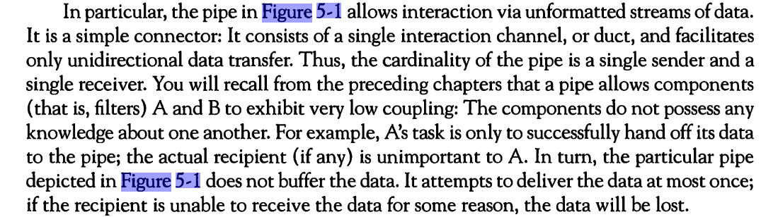
An Example of Explicit Connectors
Software Architecture: Foundations, Theory, and Practice; Richard N. Taylor, Nenad Medvidovic, and Eric M. Dashofy; © 2008 John Wiley & Sons, Inc. Reprinted with permission.

Slide 10
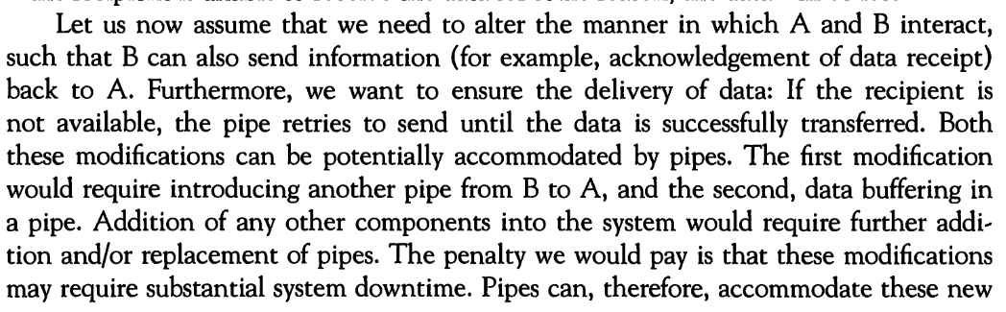
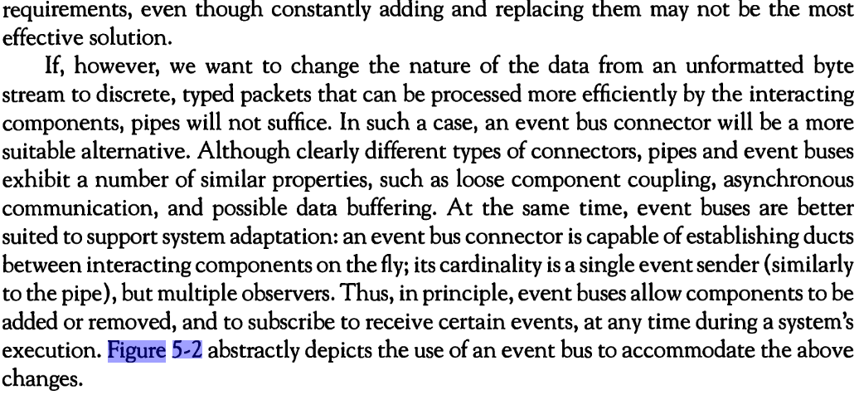

Slide 11


An Example of Explicit Connectors (cont’d)
Software Architecture: Foundations, Theory, and Practice; Richard N. Taylor, Nenad Medvidovic, and Eric M. Dashofy; © 2008 John Wiley & Sons, Inc. Reprinted with permission.

Slide 12
Software Connector Roles
Locus/venue of interaction among set of components
Protocol specification (sometimes implicit) that defines its properties
  Types of interfaces it is able to mediate
  Assurances about interaction properties
  Rules about interaction ordering
  Interaction commitments (e.g., performance)
Notes:
Locus = venue

Slide 13

Connector Roles
Roles
  Communication
  Coordination
  Conversion
  Facilitation

Slide 14
Connectors as Communicators [Data]
Main role associated with connectors
Supports
  Different communication mechanisms
    e.g. procedure call, RPC, shared data access, message passing
  Constraints on communication structure/direction
    e.g. pipes
  Constraints on quality of service
    e.g. persistence
Separates communication from computation
May influence non-functional system characteristics
  e.g. performance, scalability, security
Notes:
Message passing is a way to transfer data and instructions between two or more parallel processes.
The method invocation statement calls a method defined for the class of a reference variable

Slide 15
Connectors as Coordinators [control]
Determine computation control
Control delivery of data
Separates control from computation
Orthogonal to communication, conversion, and facilitation
  Elements of control are in communication, conversion and facilitation

Slide 16
Connectors as Converters
Enable interaction of independently developed, mismatched components
Mismatches based on interaction
  Type
  Number
  Frequency
  Order
Examples of converters
  Adaptors (bridge the gap between two/more interfaces)
  Wrappers (to simplify an interface)

Slide 17

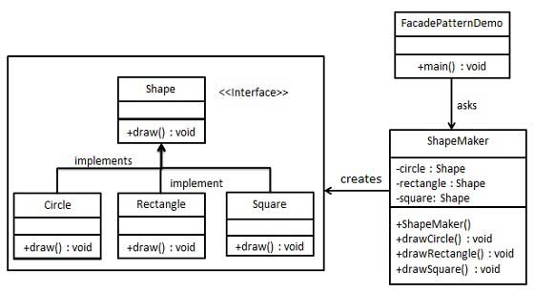
Wrapper: Façade
Notes:
https://sceweb.sce.uhcl.edu/helm/WEBPAGES-SoftwareDesignPatterns/myfiles/TableContents/Module-13/design_patterns__facade_pattern.html

Slide 18
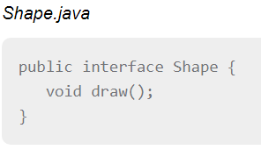
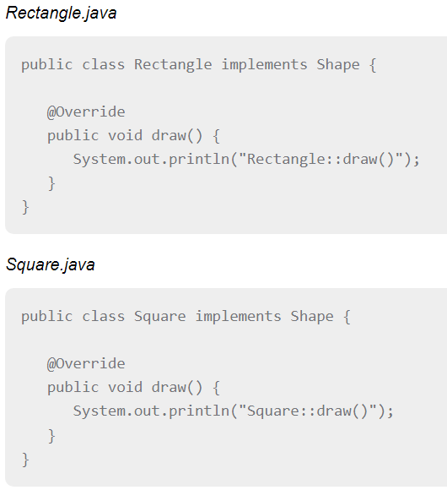
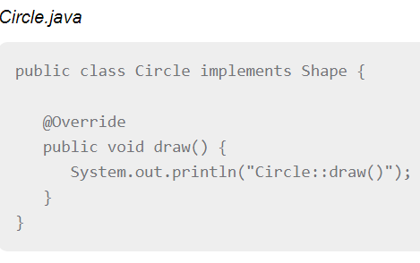

Slide 19
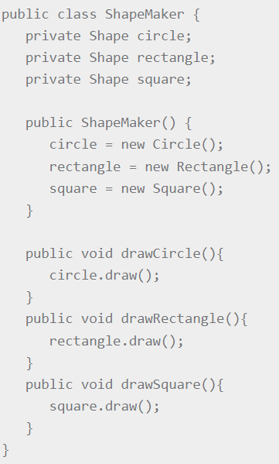
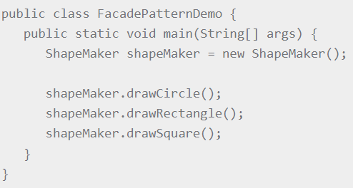
Façade Class

Slide 20
Connectors as Facilitators
Enable interaction of components intended to interoperate
  Mediate and streamline interaction
Govern access to shared information
Ensure proper performance profiles
  e.g., load balancing
Provide synchronization mechanisms
  Monitors {structures}
    Semaphores
    Wait , signal
Notes:
What are monitors in process synchronisation?
In concurrent programming, a monitor is a synchronization construct that allows threads to have both mutual exclusion and the ability to wait (block) for a certain condition to become false.

Slide 21
Connector Types
Procedure call
Data access
Event
Stream
Linkage
Distributor
Arbitrator
Adaptor

Slide 22
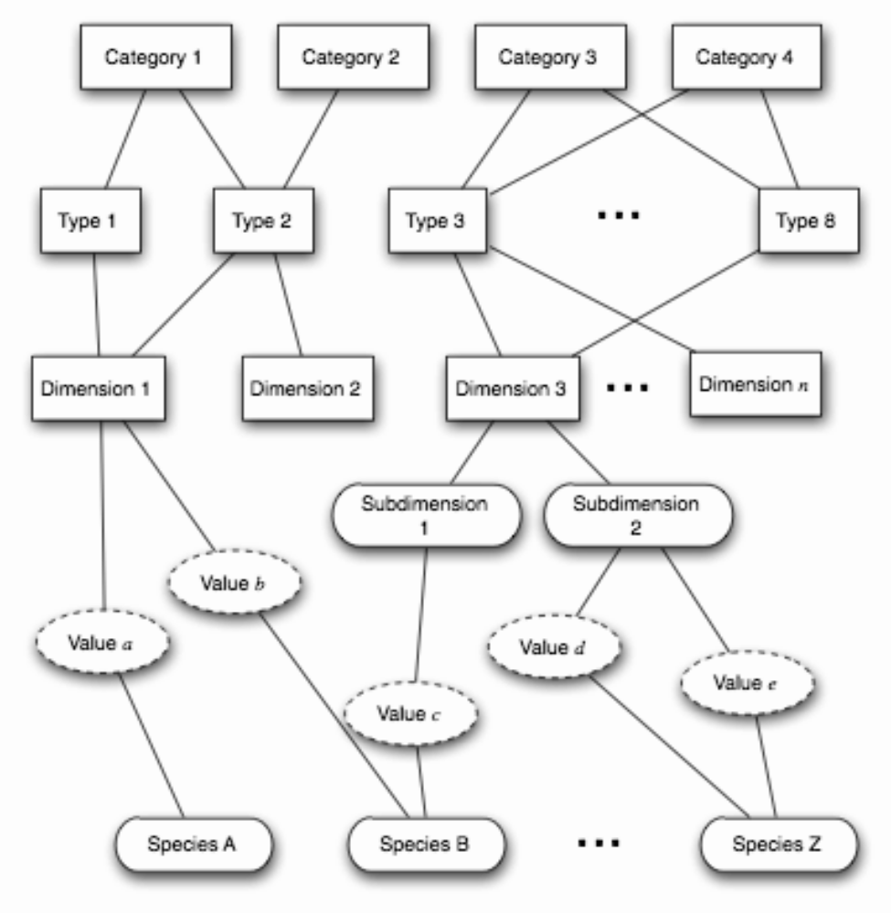
A Framework for Classifying Connectors
Software Architecture: Foundations, Theory, and Practice; Richard N. Taylor, Nenad Medvidovic, and Eric M. Dashofy; © 2008 John Wiley & Sons, Inc. Reprinted with permission.

Slide 23
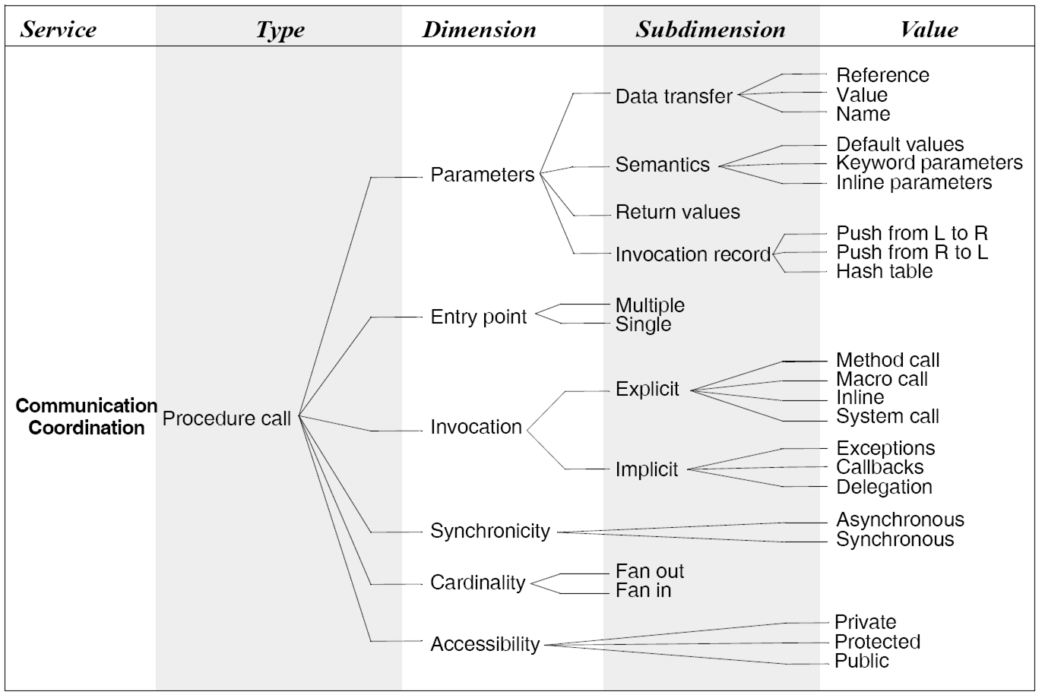
Procedure Call Connectors
Software Architecture: Foundations, Theory, and Practice; Richard N. Taylor, Nenad Medvidovic, and Eric M. Dashofy; © 2008 John Wiley & Sons, Inc. Reprinted with permission.
Notes:
Callbacks are so-called due to their usage with pointer languages. If you don't use one of those, don't labour over the name 'callback'. Just understand that it is just a name to describe a method that's supplied as an argument to another method, such that when the parent method is called (whatever condition, such as a button click, a timer tick etc) and its method body completes, the callback function is then invoked.
https://people.cs.clemson.edu/~rlowe/cs2310/notes/ln_multiple_entries.pdf
https://stackoverflow.com/questions/838079/what-is-pass-by-name-and-how-does-it-work-exactly
By using Inheritance , a subclass inherits all of the variables and all of the methods defined in the superclass. While by delegation you write another class with additional functionality that uses instances of the original class to provide the original functionality.
Pass by name is a parameter passing method that waits to evaluate the parameter value until it is used.
https://www.geeksforgeeks.org/delegation-vs-inheritance-java/

Slide 24
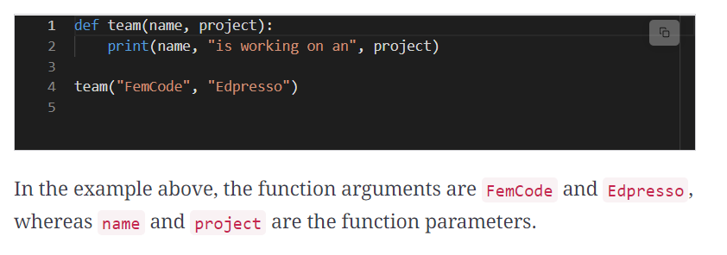
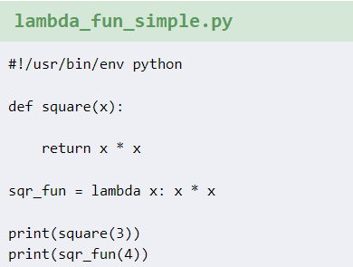
Procedure Call: Values
Macros:
#define sq(x) x * x;

Slide 25
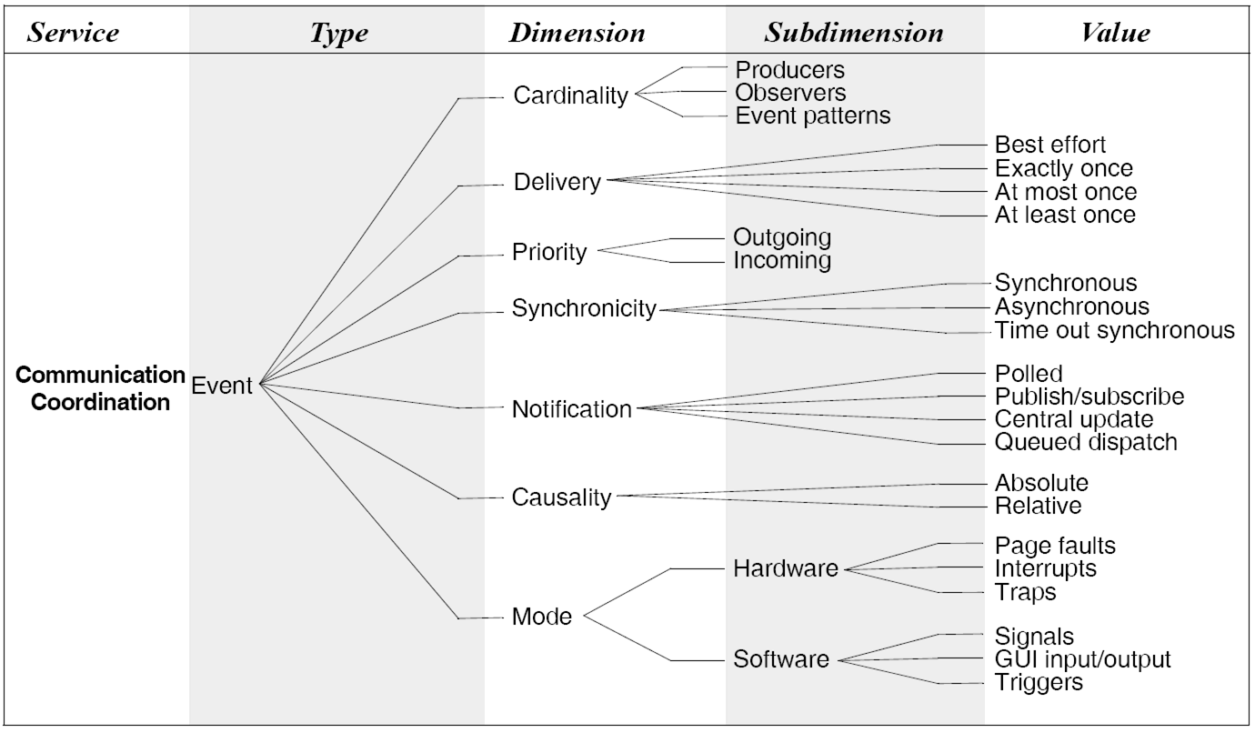
Event Connectors
Software Architecture: Foundations, Theory, and Practice; Richard N. Taylor, Nenad Medvidovic, and Eric M. Dashofy; © 2008 John Wiley & Sons, Inc. Reprinted with permission.
Notes:
https://stackoverflow.com/questions/44204973/difference-between-exactly-once-and-at-least-once-guarantees
Events are generated at the normal/abnormal end of procedural call completion. Event connects are dynamically used/created as compare to static creation of methods.
Polled : checking for updates continuously after intervals and then disseminating the information. E.g., Flicker used by processes
https://developer.apple.com/library/archive/documentation/General/Conceptual/ConcurrencyProgrammingGuide/OperationQueues/OperationQueues.html
The "page fault in nonpaged area" error can be caused by one or any combination of the following issues: Corrupt or damaged RAM. Faulty driver. Windows' inability to find files that are supposed to be in the nonpaged area.
during a system call, a TRAP instruction would force kernel to execute the system call code inside kernel (kernel mode) on behalf of the process. Trap and exception are often used interchangeably. Signals: signals are generated by kernel and sent to the process in the event of an exception.
Relative event is with respect to time or action related to user action and absolute is when the even happens and it has to be notified/broadcasted.
https://www.edureka.co/blog/triggers-in-sql/

Slide 26
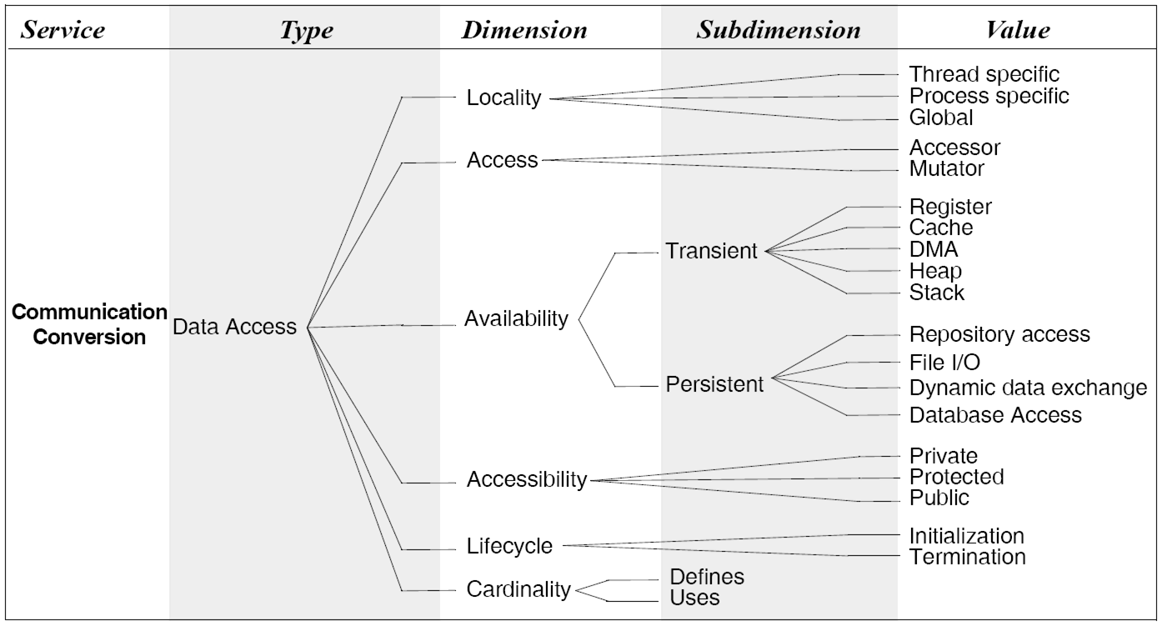
Data Access Connectors
Software Architecture: Foundations, Theory, and Practice; Richard N. Taylor, Nenad Medvidovic, and Eric M. Dashofy; © 2008 John Wiley & Sons, Inc. Reprinted with permission.

Slide 27
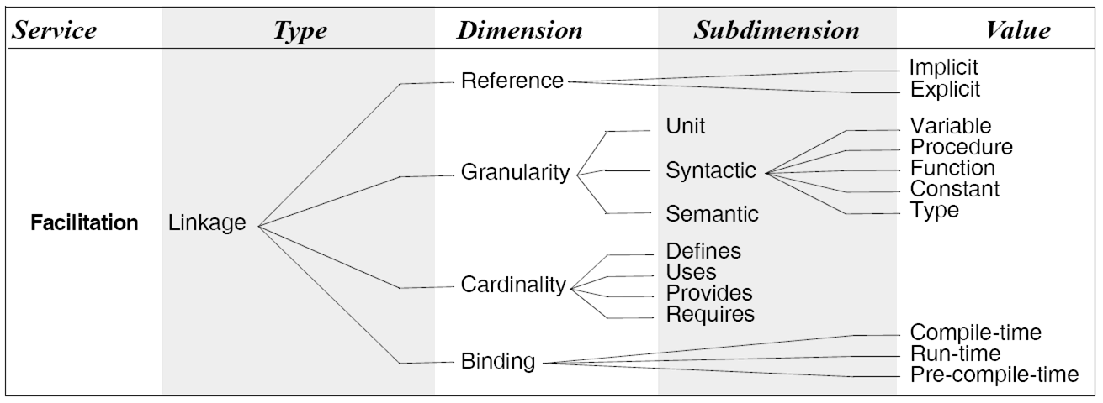
Linkage Connectors
- Extensively Code Driven Components
Implicitly used libraries:
https://docs.python.org/3/library/functions.html
Cardinality: Number of places where a resource ( e.g., variable, functions, components) is defined, used, provided, and required.
Software Architecture: Foundations, Theory, and Practice; Richard N. Taylor, Nenad Medvidovic, and Eric M. Dashofy; © 2008 John Wiley & Sons, Inc. Reprinted with permission.
Notes:
Implicitly used libraries:
https://docs.python.org/3/library/functions.html
Cardinality: Number of places where a resources ( e.g., variable, functions, components) is defined, used, provided, and required.

Slide 28
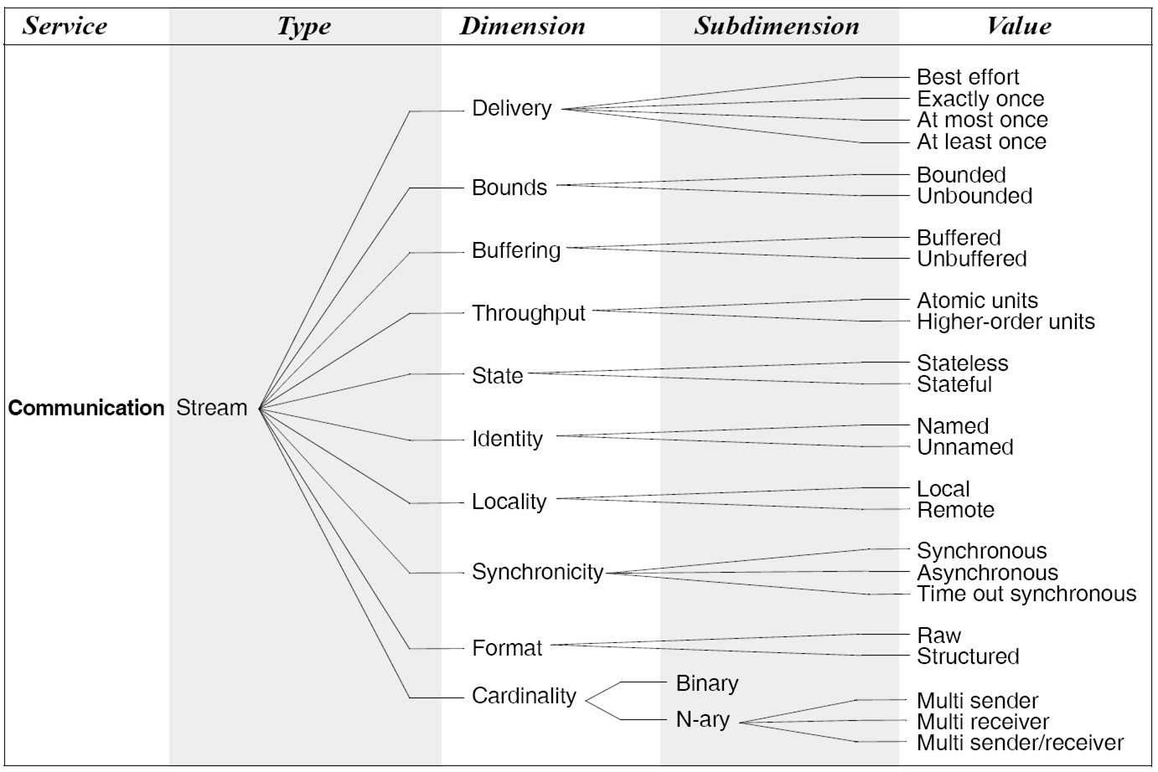
Stream Connectors
Software Architecture: Foundations, Theory, and Practice; Richard N. Taylor, Nenad Medvidovic, and Eric M. Dashofy; © 2008 John Wiley & Sons, Inc. Reprinted with permission.
Notes:
https://stackoverflow.com/questions/37246610/stateful-and-stateless-streaming-processing
Stream throughputs are measured in atomic units (bits/sec) or higher order units (Mb/Kb /sec)
Identity: a built-in functions of a programming language is being used or self defined.
Best-effort delivery describes a network service in which the network does not provide any guarantee that data is delivered or that delivery meets any quality of service. In a best-effort network, all users obtain best-effort service. Under best-effort, network performance characteristics such as network delay and packet loss depend on the current network traffic load, and the network hardware capacity. When network load increases, this can lead to packet loss, retransmission, packet delay variation, and further network delay, or even timeout and session disconnect.

Slide 29
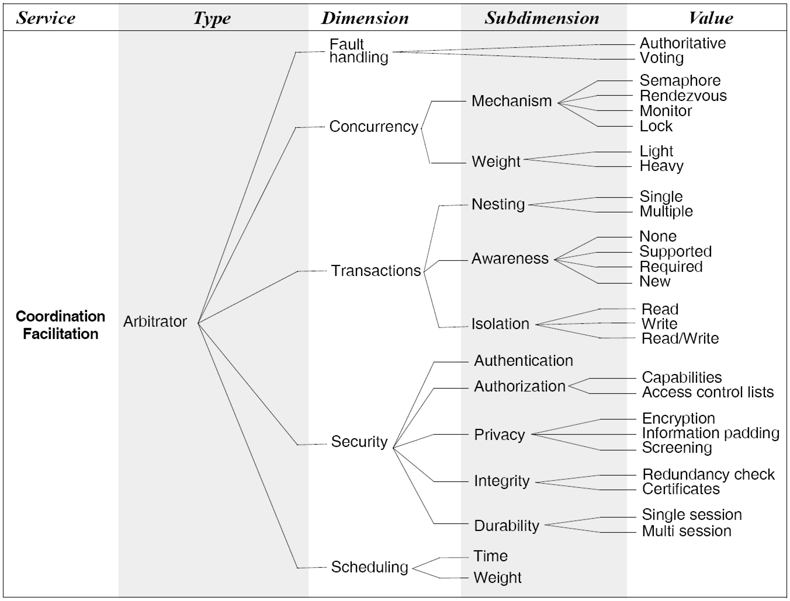
Arbitrator Connectors
Software Architecture: Foundations, Theory, and Practice; Richard N. Taylor, Nenad Medvidovic, and Eric M. Dashofy; © 2008 John Wiley & Sons, Inc. Reprinted with permission.
Notes:
WatchDog mechanism (voting group) Vs Single core maintaining close look at the other cores.
A nested transaction in distributed systems is used to provide a transactional guarantee for a subset of operations performed within the scope of a larger transaction. Doing this allows you to commit and abort the subset of operations independently of the larger transaction.
Transactions in SQL Server Integration Services
Required - if a transaction exists join it else start a new one
Supported - if a transaction exists join it (this is the default)
NotSupported - do not join an existing transaction
An access control list (ACL) is a table that tells a computer operating system which access rights each user has to a particular system object, such as a file directory or individual file. Each object has a security attribute that identifies its access control list.
The digital signature confirms the integrity of the message. This signature ensures that the information originated from the signer and was not altered, which proves the identity of the organization that created the digital signature. Any change made to the signed data invalidates the whole signature.
http://sunnyday.mit.edu/papers/assertions.pdf
https://en.wikipedia.org/wiki/Concurrent_computing
https://prosuncsedu.wordpress.com/2014/08/21/comparing-object-centric-access-control-mechanisms-acl-capability-list-attribute-based-access-control/

Slide 30
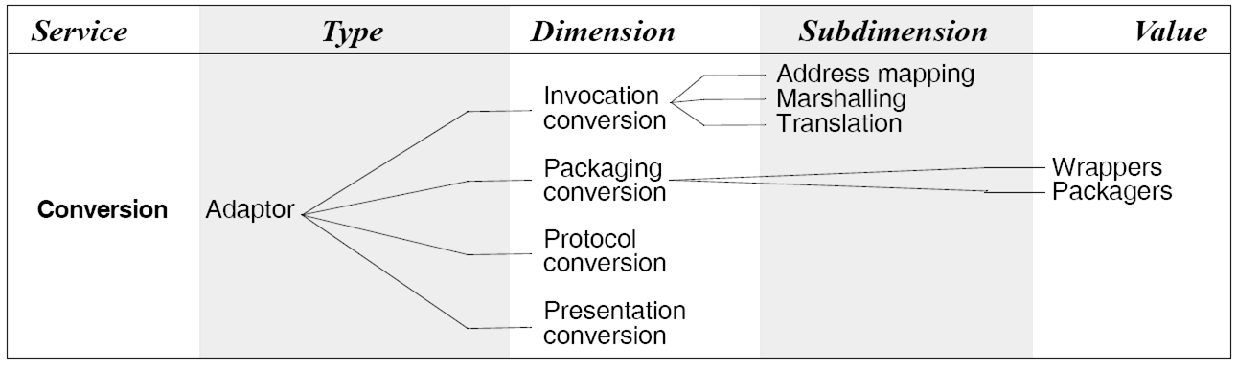
Adaptor Connectors
Software Architecture: Foundations, Theory, and Practice; Richard N. Taylor, Nenad Medvidovic, and Eric M. Dashofy; © 2008 John Wiley & Sons, Inc. Reprinted with permission.
Notes:
http://www.thecodedself.com/The-Difference-Between-an-Adapter-and-a-Wrapper/
To "serialize" an object means to convert its state into a byte stream in such a way that the byte stream can be converted back into a copy of the object.
If you’re serializing and de-serializing Python objects, use the pickle module instead
https://docs.oracle.com/javase/tutorial/java/concepts/package.html
Used where interoperability b/w heterogeneous systems is required.
Interoperability, protocol conversion, data transformation, legacy systems integration.

Slide 31
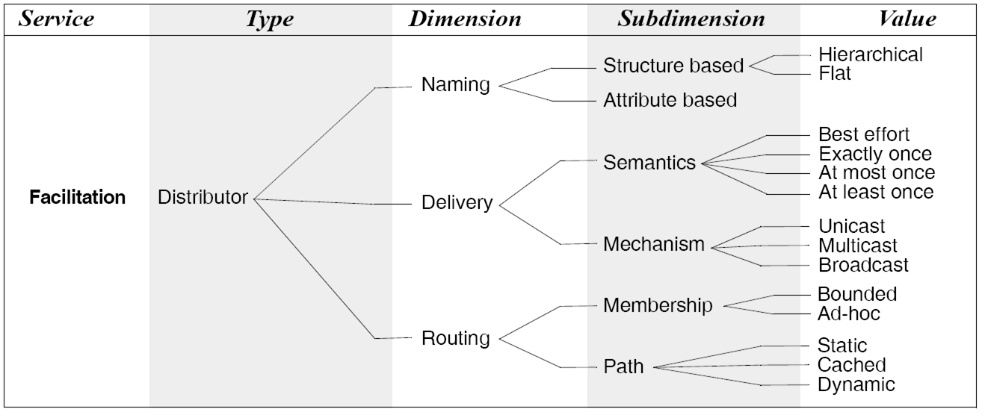
Distributor Connectors [distributed systems]
Software Architecture: Foundations, Theory, and Practice; Richard N. Taylor, Nenad Medvidovic, and Eric M. Dashofy; © 2008 John Wiley & Sons, Inc. Reprinted with permission.
Notes:
https://www.routeralley.com/guides/static_dynamic_routing.pdf
Distributed systems require identification of components locations and paths to them based on symbolic names such as Domain name service, creating groups in windows.
A Unicast transmission/stream sends IP packets to a single recipient on a network. A Multicast transmission sends IP packets to a group of hosts on a network. Broadcast or broadcasting is a method of transferring a message to all recipients simultaneously while multicast is a group communication where data transmission is addressed to a group of destination computers simultaneously.
Using the route cache will drastically decrease the amount of time it takes to register all of your application's routes. In some cases, your route registration may even be up to 100x faster.
The main difference between IPv4 and IPv6 is the address size of IP addresses. The IPv4 is a 32-bit address, whereas IPv6 is a 128-bit hexadecimal address. IPv6 provides a large address space, and it contains a simple header as compared to IPv4.
Load balancing, parallel processing, Scalability, Fault tolerance, event distribution, message queuing, monitoring and management.

Slide 32
How Does One Select a Connector?
Determine a system’s interconnection and interaction needs
  Software interconnection models can help
Determine roles to be fulfilled by the system’s connectors
  Communication, coordination, conversion, facilitation
For each connector
  Determine its appropriate type(s)
  Determine its dimensions of interest
  Select appropriate values for each dimension
For multi-type, i.e., composite connectors
  Determine the atomic connector compatibilities
Notes:
Unit interconnection: dependence/linkage between components, file, objects
Syntactic interconnection: dependence/linkage between variables, methods, constants of two/more components, file, objects
Semantic interconnection: how the components interact with each other i.e., interaction requirements, assumptions

Slide 33
Simple Example
System components will execute in two processes on the same host
  Mostly intra-process
  Occasionally inter-process
The interaction among the components is synchronous
The components are primarily computation-intensive
  There are some data storage needs, but those are secondary

Slide 34
Simple Example (cont’d)
Select procedure call connectors for intra-process interaction
Combine procedure call connectors with distributor connectors for inter-process interaction
  RPC
Select the values for the different connector dimensions
  What are the appropriate values?
  What values are imposed by your favorite programming language(s)?

Slide 35
Procedure Call Connectors Revisited
Software Architecture: Foundations, Theory, and Practice; Richard N. Taylor, Nenad Medvidovic, and Eric M. Dashofy; © 2008 John Wiley & Sons, Inc. Reprinted with permission.

Slide 36
Distributor Connectors Revisited
Software Architecture: Foundations, Theory, and Practice; Richard N. Taylor, Nenad Medvidovic, and Eric M. Dashofy; © 2008 John Wiley & Sons, Inc. Reprinted with permission.

Slide 37
Two Connector Types in Tandem
Select the appropriate
values for PC and RPC!
Software Architecture: Foundations, Theory, and Practice; Richard N. Taylor, Nenad Medvidovic, and Eric M. Dashofy; © 2008 John Wiley & Sons, Inc. Reprinted with permission.

Slide 38
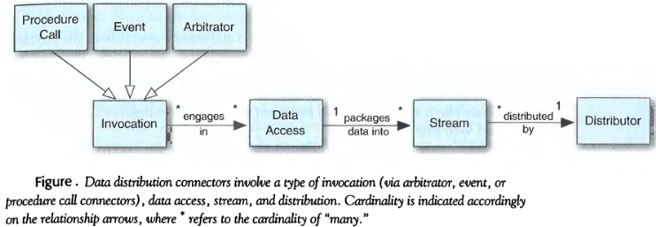
The Choices and the Relationship
The following figure illustrates the choices and the relationship for the invocation of connector classes

Slide 39
Discussion
Connectors allow modeling of arbitrarily complex interactions
Connector flexibility aids system evolution
  Component addition, removal, replacement, reconnection, migration
Support for connector interchange is desired
  Aids system evolution
  May not affect system functionality

